Slide 1

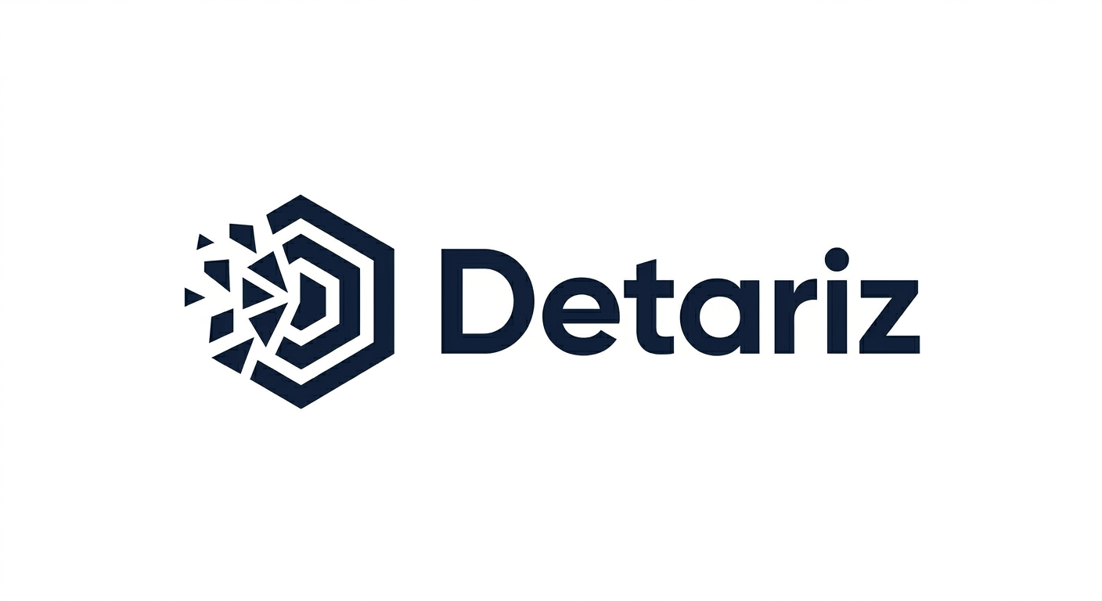
Detariz
Applied AI & Data Science for Complex Business Workflows
We help mid-size and enterprise organizations move AI from pilot to production — turning messy data and fragmented workflows into measurable business outcomes.

Slide 2

The Problem: AI Stuck Before Production
Most organizations have the data, the ambition, and the tools. What's missing is the bridge between AI experiments and real-world impact.
Messy Data
Siloed, inconsistent, and unstructured data that resists analysis
Document Chaos
Critical insights buried in reports, PDFs, and unstructured files
Broken Workflows
Manual processes that slow decisions and create operational drag
Stalled Pilots
AI projects that never make it past the proof-of-concept stage

Slide 3
What We Do
Five core capabilities designed to take your AI and data initiatives from strategy through production.
AI & Data Strategy
Data Science & ML
GenAI & Document Intelligence
Align AI investments with business objectives and build a clear roadmap
Custom models that predict outcomes, detect patterns, and drive decisions
Extract, summarize, and act on insights trapped in unstructured content
Data Engineering & Analytics
AI Production & Governance
Build reliable data infrastructure that powers real-time analytics
Deploy, monitor, and govern AI systems with confidence and compliance

Slide 4
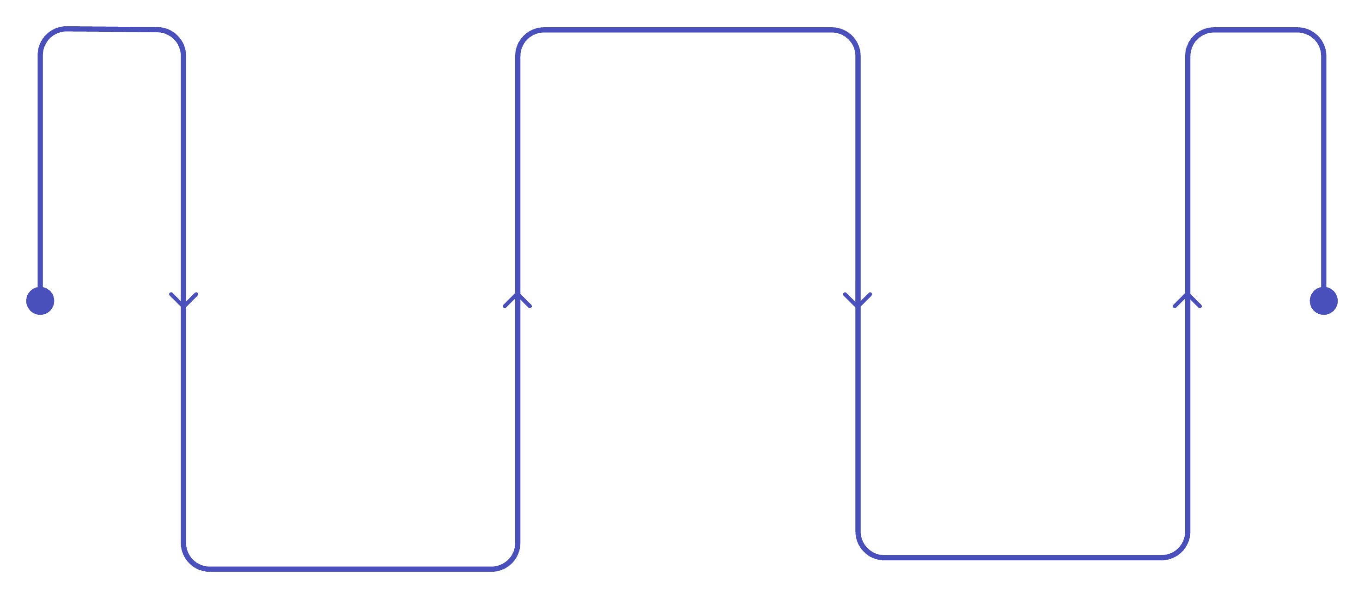
The D2P Framework
OUR CORE METHODOLOGY
Every engagement follows a proven three-stage path — from raw data, to intelligent decisions, to production-grade systems. D2P eliminates the gap between AI potential and AI results.
Decisions
Apply AI/ML/GenAI for actionable insights
Data
Production
Collect, clean, and structure raw data
Deploy, govern, and scale AI systems
The D2P Framework ensures no project stalls at the proof-of-concept stage. Each phase builds on the last, creating a repeatable path from data to deployed intelligence.

Slide 5
Example Use Cases
Across industries and functions, Detariz delivers AI systems that drive real operational value.
Reporting Intelligence
Document Intelligence
Automate report generation and surface anomalies before they become problems
Parse contracts, invoices, and reports to extract key data at scale
Predictive Intelligence
Operations Intelligence
Forecast demand, churn, and risk with production-grade ML models
Optimize workflows and reduce manual effort with intelligent automation
Knowledge Assistants
AI Production Systems
Deploy AI-powered assistants that answer questions and retrieve context instantly
End-to-end deployment of AI pipelines with monitoring and governance built in

Slide 6




How We Engage
ENGAGEMENT MODEL
We start lean and scale with you. Our four-stage model is designed to deliver value quickly, then deepen the partnership as results compound.
Opportunity Call
Audit
30-minute discovery conversation to understand your goals, data landscape, and AI readiness
Assessment of your data, workflows, and AI maturity with a prioritized action plan
Sprint
Retainer
Focused 2–4 week engagement to deliver a working prototype or quick-win use case
Ongoing partnership for continuous AI development, deployment, and governance

Slide 7


Let's Start the Conversation
The fastest way to understand what Detariz can do for your organization is a focused, no-obligation AI & Data Opportunity Call. We'll explore your challenges, identify quick wins, and outline a clear path forward.
📞 Book a Call
Schedule your AI & Data Opportunity Call with a Detariz expert
📄 Request the Deck
Download or request our full Capability Deck for your team
Ready to move AI from pilot to production? Reach out today and let's map your path from data to decisions to production.

